Slide 1


Seminar
on
“Machine Learning with Python”
Presented By:
Pooja Jain RTU Roll no. – 21EJCCS168
Guided By:
Mr. Sunil Sharma
Assistant Professor, CSE Dept.

Slide 2
Contents
VISION AND MISSION OF INSTITUTE
Vision of the Institute
To become a renowned centre of higher learning, and work towards academic, professional, cultural and social enrichment of the lives of individuals and communities.
Mission of the Institute
To Focus on research and spirit of innovation that will drive academic orientation and pursuit at JECRC.
To Identify, based on informed perception of Indian, regional and global needs, areas of focus and specialization on which the institute can concentrate.
To Undertake collaborative projects that offer opportunities for long-term interaction between academia and industry.
To Develop human potential to its fullest extent so that intellectually capable and imaginatively gifted leaders can emerge in a range of professions.

Slide 3
Contents
VISION AND MISSION OF DEPARTMENT
Vision of the Department
To become renowned Centre of excellence in computer science and engineering and make competent engineers & professionals with high ethical values prepared for lifelong learning.
Mission of the Department
M1- To impart outcome based education for emerging technologies in the field of computer science and engineering.
M2 - To provide opportunities for interaction between academia and industry.
M3-To provide platform for lifelong learning by accepting the change in technologies
M4 - To develop aptitude of fulfilling social responsibilities.

Slide 4
Contents
COURSE OUTCOMES (COs)
CO1: Generate the report based on the Projects carried out for demonstrating the ability to apply the knowledge of engineering field during training
CO2: Demonstrate Competency in relevant engineering fields through problem identification, formulation and solution

Slide 5
CONTENTS
Introduction to Python
History of Python
Installing Python
Uses of Python
Features of Python
Usage of Python by top companies
Why Python is important
Introduction to ML and its classification
How does ML works
Usage of ML
Why is ML important
Advantage and Disadvantage of ML
Project description

Slide 6
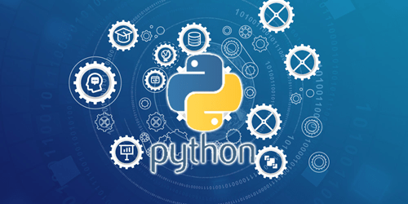
INTRODUCTION TO PYTHON
Python is a general purpose programming language that is often applied in scripting roles.
Hence, Python is both programming language and scripting language.
Python is also called as Interpreted language.
It is a high level and open source language

Slide 7
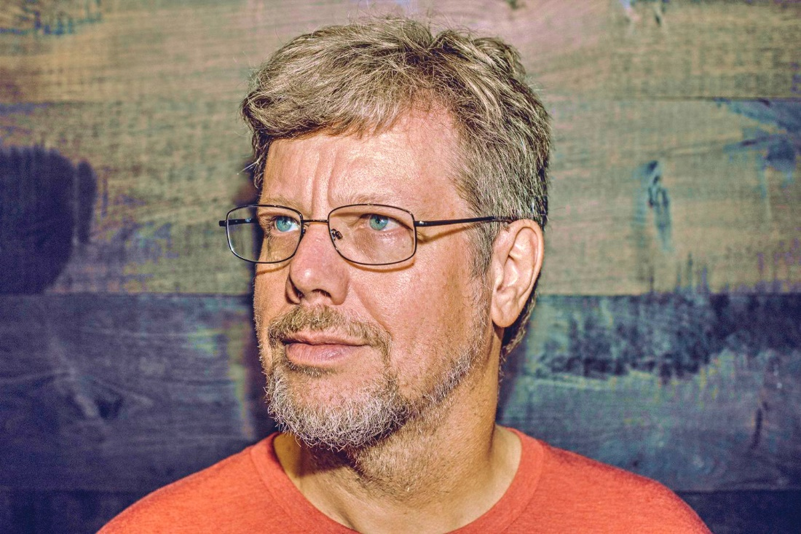
HISTORY OF PYTHON
Invented in the Netherlands, in early 90s Guido Van Rossum.
Named after Monty Python and his circus whose the founder was a fan.
Python was conceived in the late 1980s and its implementation was started in 1989.

Slide 8
INSTALLING PYTHON
Python is pre installed on most Unix systems , including Linux and MAC OS X
But for in Windows Operating Systems , user can download from the https://www.python.org/downloads/
-from the above link download latest versions of python IDE and install, recent version is 3.4.1 but most of them uses version 2.7.7 only
After installing the Python version , go to start menu then click on python 2.7 in that one we can select python (command line) it is prompt with >>>

Slide 9
USES OF PYTHON
Web application
Computer graphics
Game development
System software
App development
Website creation

Slide 10
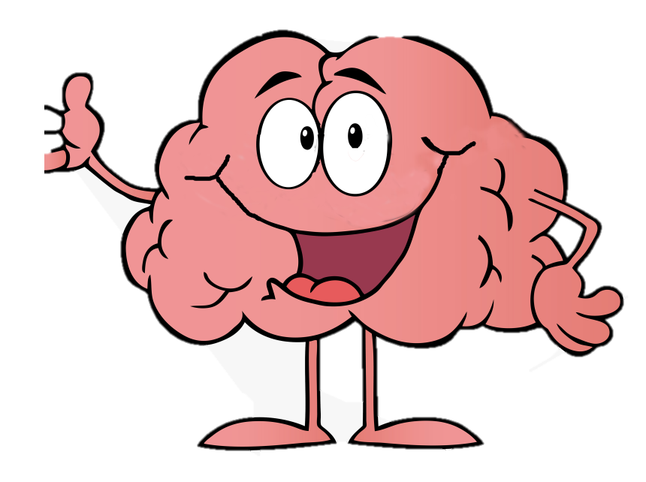

FEATURES OF PYTHON
a. Easy to read , learn and maintain
b. Portable : It can run over various
hardware platform and has the same
interface on all platform
c. Scalable : Python has a broad standard cross platform

Slide 11

d. Everything in Python is an object: variables , functions ,even code ; every object has an ID ,a type , and a value.

Slide 12





USAGE OF PYTHON BY TOP COMPANIES
Makes extensive
Use in web search
system
In revenue generating products by real companies
For hardware testing

Slide 13
Why Python is popular?
Object Oriented Programming Language.
Interpreted language.
Platform Independent.
Open source language, hence, free.
Highly appreciated because of ease to learn and use.

Slide 14
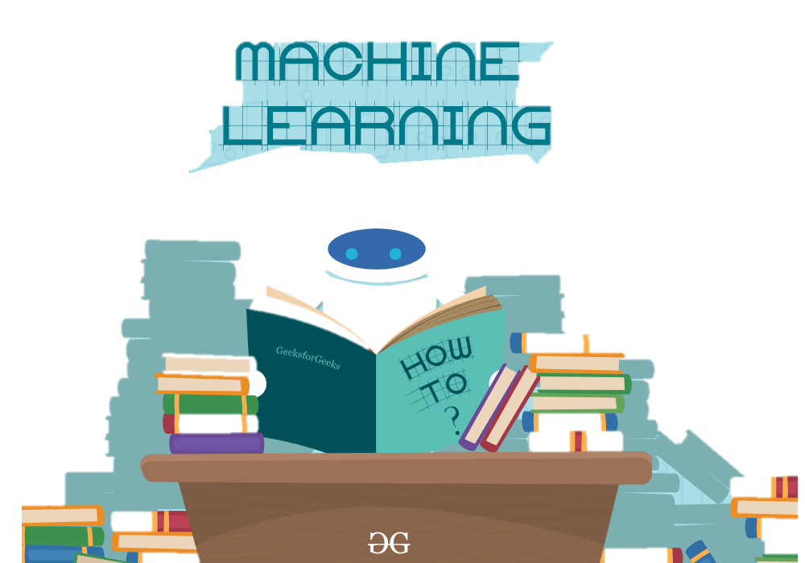
INTRODUCTION TO MACHINE LEARNING
Machine learning is a growing technology which enables computers to learn automatically from past data. Machine learning uses various algorithms for building mathematical models and making predictions using historical data or information.

Slide 15

Currently, it is being used for various tasks such as image recognition, speech recognition, email filtering, Facebook auto-tagging, recommender system, and many more.
The term machine learning was first introduced
by Arthur Samuel in 1959.
We can define it in summarized way as:
“Machine learning enables a machine to automatically learn from data, improve performance from experiences,and predict things without being explicitly programmed.”

Slide 16
CLASSIFICATION OF MACHINE LEARNING
SUPERVISED
LEARNING
UN-
SUPERVISED
LEARNING
SEMI-
SUPERVISED
LEARNING
REIN-
FORCEMENT
LEARNING

Slide 17
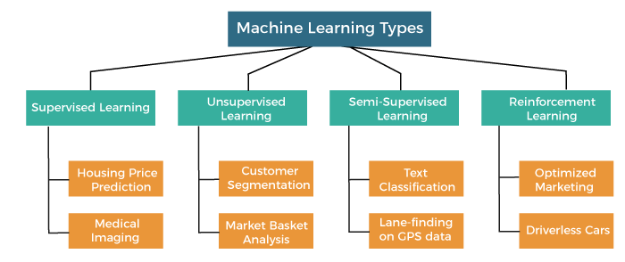

Slide 18
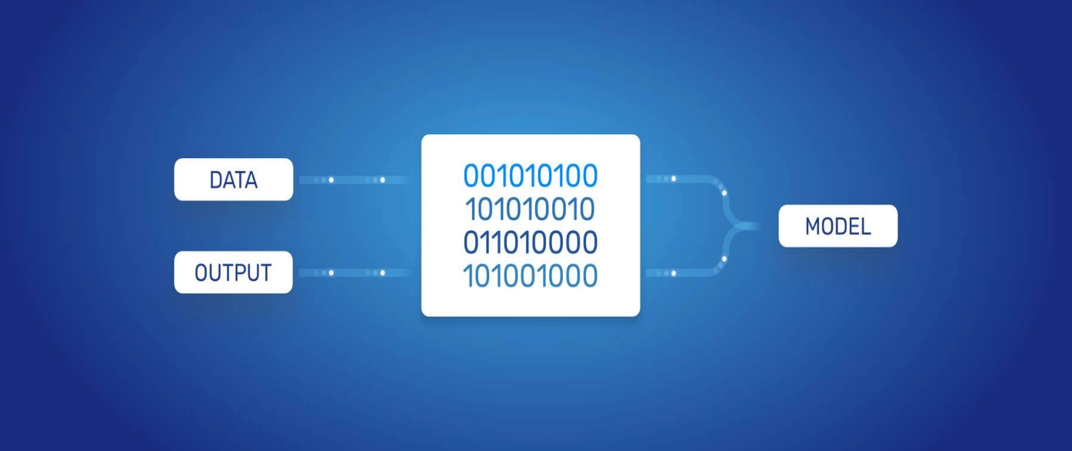
HOW DOES MACHINE LEARNING WORKS
Machine learning is a form of artificial intelligence (AI) that teaches computers to think in a similar way to how humans do: Learning and improving upon past experiences. It works by exploring data and identifying patterns, and involves minimal human intervention.

Slide 19

USE CASES OF MACHINE LEARNING
Social Media Monitoring
Customer Service & Customer Satisfaction
Image Recognition
Virtual Assistants
Product Recommendations
Stock Market Trading
Medical Diagnosis

Slide 20
ML vs AI vs DEEP LEARNING
ML : MACHINE LEARNING
It is a subset of AI and it is based on the idea that we should be able to give machine the access to data and let them learn from themselves

Slide 21
AI – ARTIFICIAL INTELLIGENCE
A technique which enables machines to mimic human behaviour.
Example: While talking to Siri on our phone , we get very close or the needed answer.

Slide 22
DEEP LEARNING
It is a type of machine learning and artificial intelligence (AI) that imitates the way humans gain certain types of knowledge. Deep learning is an important element of data science, which includes statistics and predictive modeling.

Slide 23
Why is ML important?
Enterprises are given a view of trends in customer behaviour and business operational patterns. As well, it supports the development of new products.
Facebook, Google and Uber make ML a central part of their operations.

Slide 24
Advantages of ML
Easily identifies trends and patterns.
No or negligible human intervention needed.
Continuous Improvement.
Handling multi-dimensional and multi-variety-data.
Wide applications.

Slide 25
Disadvantages of ML
Data acquisiton
Time and Resources (Space)
Interpretation of Results
High error-susceptibility

Slide 26
What makes Python the best programming language for ML and AI?
Simple and consistent
Great libraries
Flexibility
Platform independent or portable

Slide 27
PROJECT
The datasets are meteorological data from the HI-SEAS weather station from four months (September through December 2016) between Mission IV and Mission V.
This machine learning application is used to predict the solar radiation condition if provided with suitable time , pressure , temperature , time to sunrise , time to sunset , humidity etc.

Slide 28
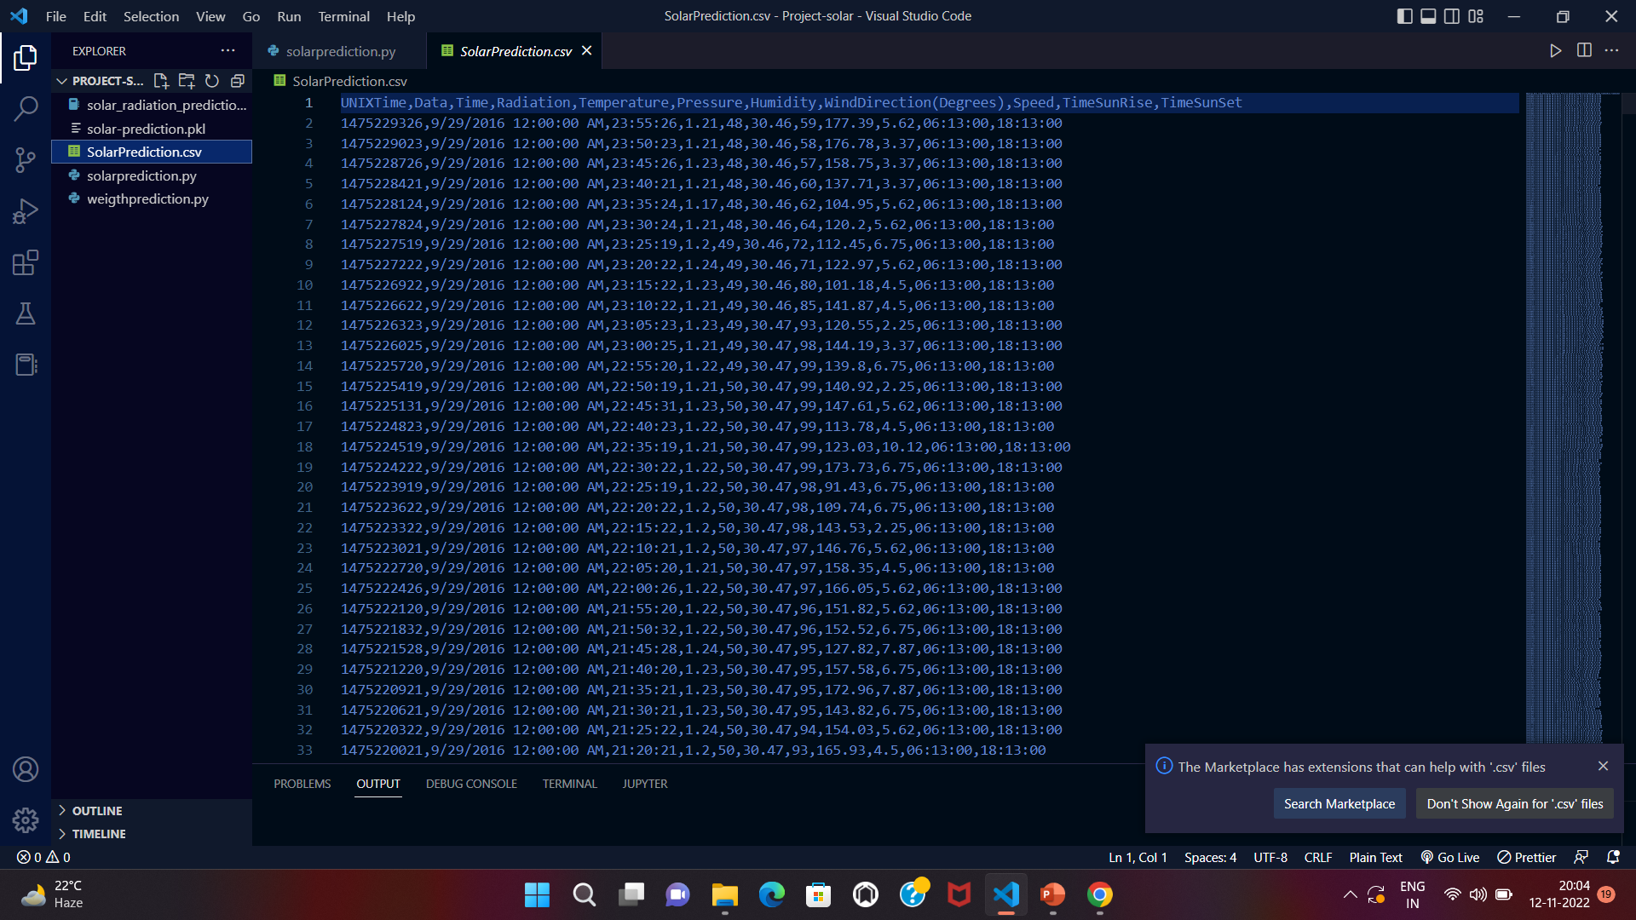
PROJECT DESCRIPTION
In this project the dataset was taken from Kaggle.com
The dataset contain 11 columns and 32686 entries as shown below

Slide 29
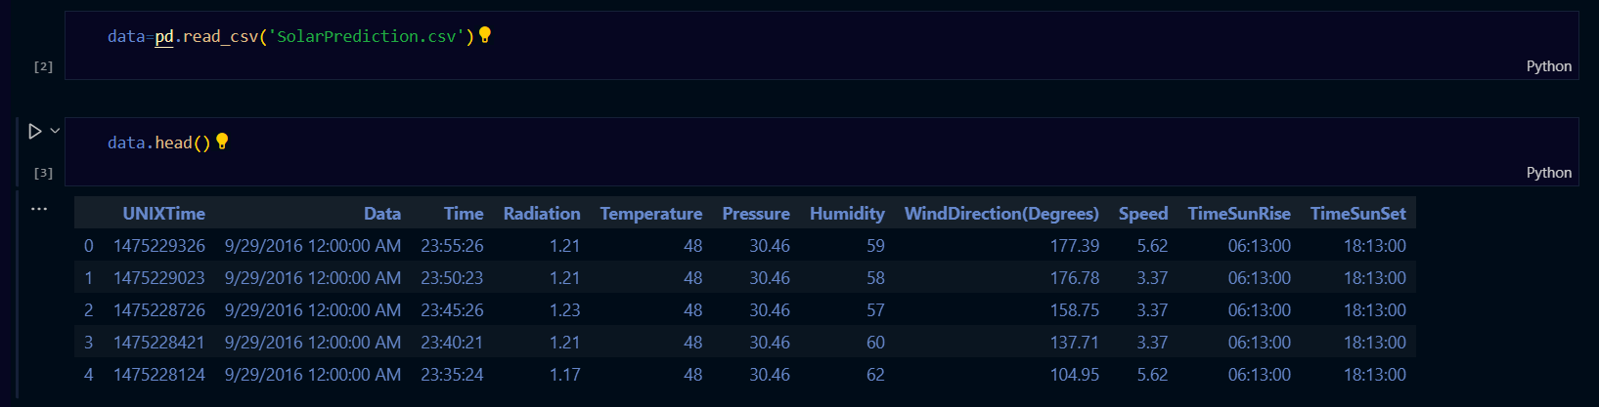
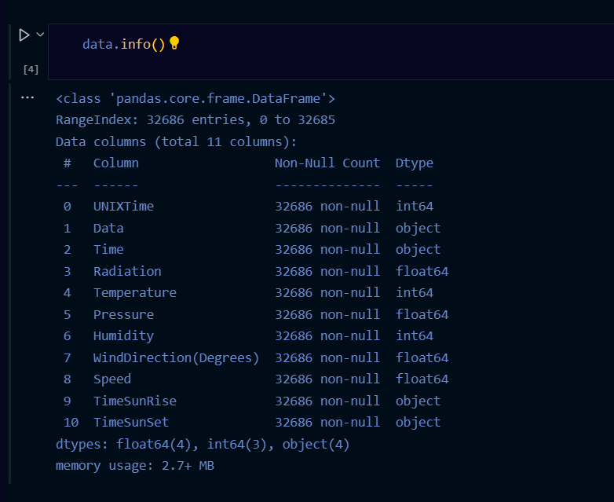
DATA VISUALIZATION

Slide 30
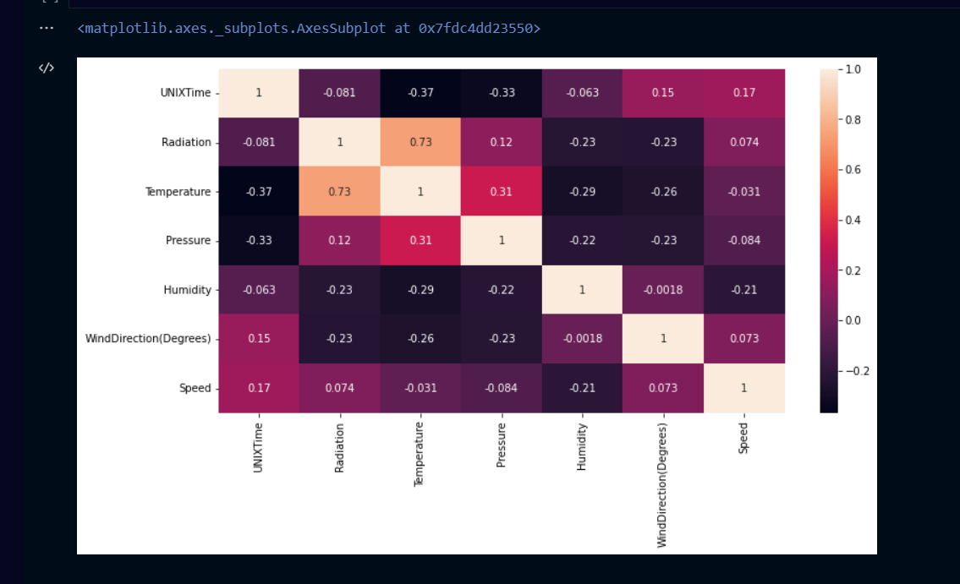
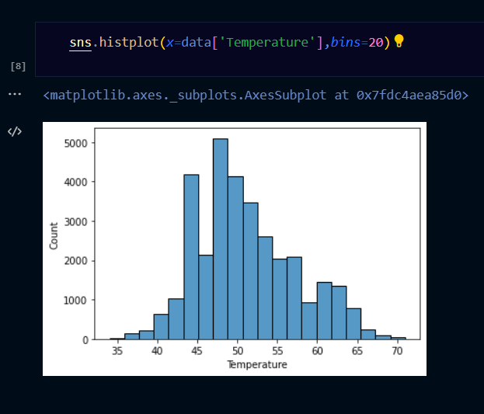
ANALYSIS OF DATA

Slide 31
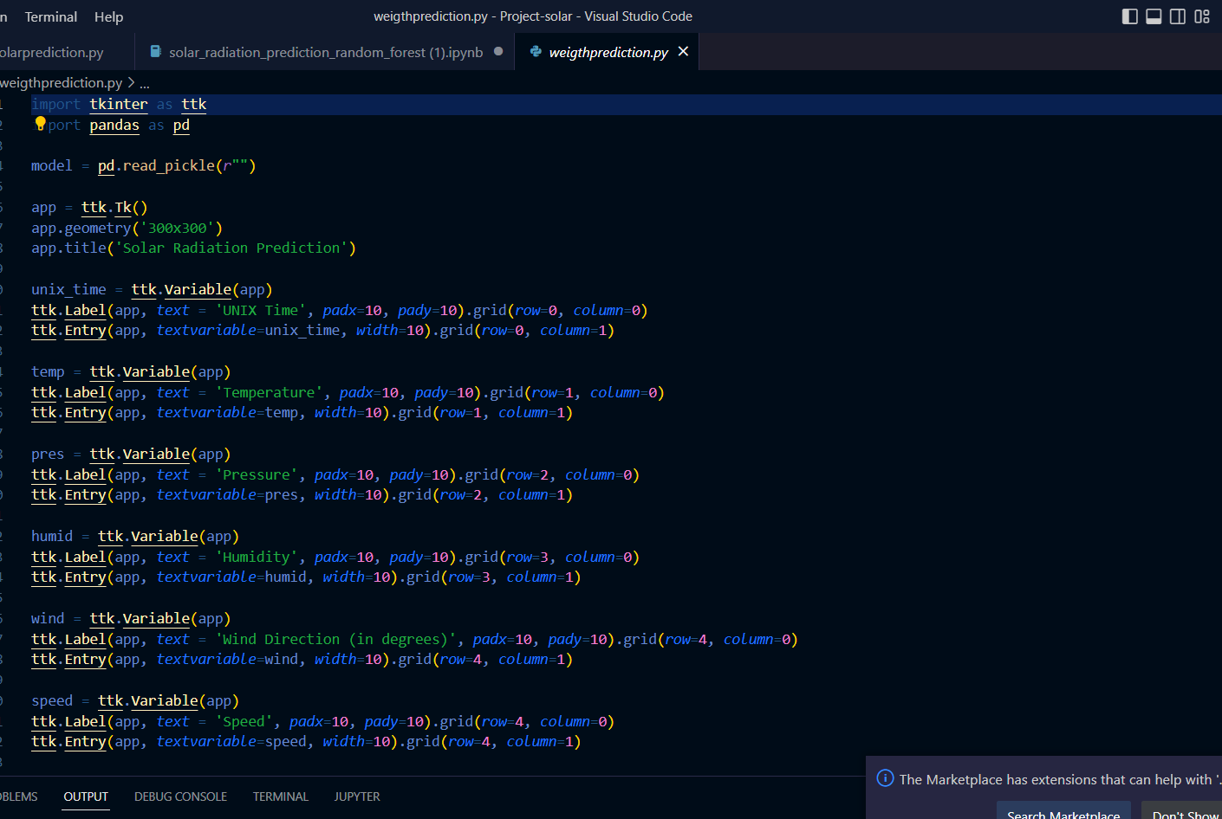
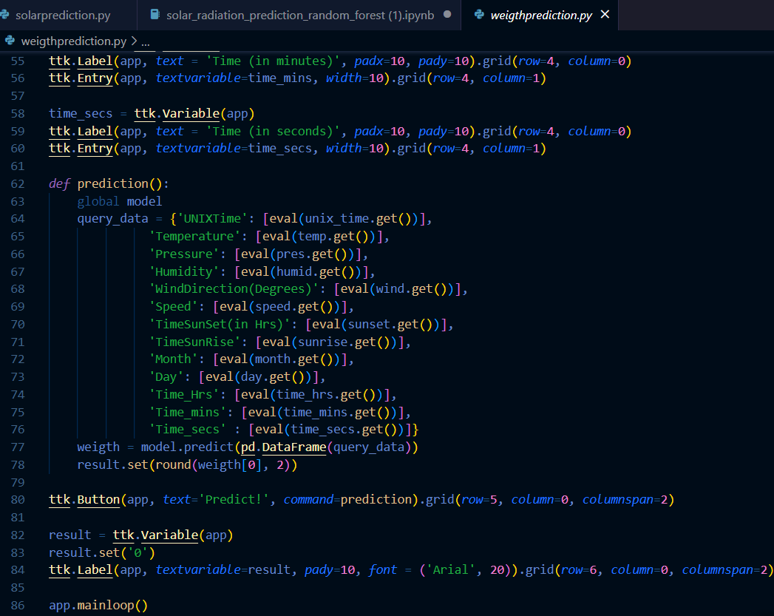
CREATING GUI FILE

Slide 32
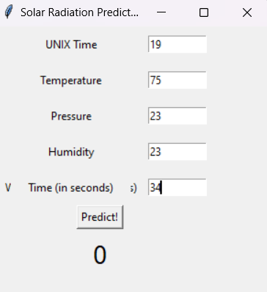
GUI INTERFACE

Slide 33
REFRENCES
www.google.com
www.geeksforgeeks.com
www.Kaggle.com
www.python.com

Slide 34
Thankyou!

